Slide 1
PERCEPTRON
Dr. B.K Tripathy

Slide 2
SUPERVISED LEARNING NETWORK (PERCEPTRON NETWORKS)
Perceptron Networks come under single-layer feed forward networks
These are also called simple Perceptrons
IN 1980S ENHANCED TO MULTI-LAYERED ONES
PERCPTRONS ARE THE PATTERN RECOGNISERS
Designed by many researchers:
Rosenblatt (1962)
Minsky- Papert (1969, 1988)
Block (1962)
The design of Block is the simplest

Slide 3
PERCEPTRON NETWORK ARCHITECTURE
Consists of 3 units
Sensory unit → input unit
Associator unit → hidden unit
Response unit →output unit
The sensory units are connected to Associator units with fixed weight connections having values 1, 0 or -1, assigned at random
The binary activation function is used in sensory unit and Associator unit
The response unit has an activation of 1, 0 or -1
The binary step with fixed threshold is used as an activation for the Associator

Slide 4
PERCEPTRON NETWORK ARCHITECTURE
The output signals that are sent from the Associator unit to the response unit are only binary
The output of the perceptron network is given by
The activation function is given by
Perceptron learning rule is used in the weight updation between the Associator unit and the response unit .
For each training input, the net will calculate the response and it will determine whether or not an error has occurred

Slide 5
PERCEPTRON NETWORK ARCHITECTURE
The error calculation is based on the comparison of the values of targets with those of the calculated outputs
The weights on the connections from the units that send the nonzero signal will get adjusted suitably
The weights will be adjusted on the basis of the learning rule if an error has occurred for a particular training pattern;
Here, the target value ‘t’ is equal to +1 or -1
is the learning rate
If there are no errors then the training process is stopped

Slide 6
PERCEPTRON LEARNING RULE
The learning signal is the difference between the desired and actual response of a neuron (i.e. the error signal)
A sensory unit generates signals for the Associator unit
The weights between sensory unit and Associator unit are fixed (cannot be changed)
These weights are chosen arbitrarily from 1, 0 and -1
Only the weights between Associator unit and response unit can be changed
Consider a finite number ‘N’ of pairs of input training vectors and associated target vectors, represented by x(n) and t(n), n = 1, 2, …N

Slide 7
PERCEPTRON LEARNING RULE CONTD…
The target is bipolar with values +1 or -1
The output ‘y’ is obtained on the basis of the net input is computed, the threshold value and the activation function ‘f’ are as follows:
The weight updation is done as follows:
There is some error

Slide 8
SINGLE CLASSIFICATION PERCEPTRON NETWORK ARCHITECTURE
arc
1
b
X1
.
.
Y
y
Xi
.
.
Xn

Slide 9
FLOW CHART FOR TRAINING PROCESS
flow
Start
Initialize weights and bias
Set alpha (0 to 1)
Learning rate

Slide 10
FLOW CHART FOR TRAINING PROCESS
flow
For each s:t
No (Pairs do not exist)
Yes. (Pairs exist)
Activate input units xi = si
Identity activation function
Calculate net input
Apply activation function y = f( )
Three values are obtained 1, 0 or -1

Slide 11
FLOW CHART FOR TRAINING PROCESS
Flow
If y!=t
No
y =t means no error. So, weight adjustment is not required
Error exists. So, weight adjustment is required
Yes
(new) = (old) +alpha.t.
b(new)= b(old)+alpha.t
(new) = (old)
b(new)= b(old)

Slide 12
FLOW CHART FOR TRAINING PROCESS
flow
If weight changes
Yes
No
Stop

Slide 13
PERCEPTRON TRAINING ALGORITHM FOR SINGLE OUTPUT CLASSES
STEP 0: (i)Initialize the weights and the bias (for easy calculation they can be set to 0)
(ii)Initialize the learning rate (For simplicity it is set to 1)
STEP 1: Perform steps 2 – 6 until the final stopping condition is false
STEP 2: Perform steps 3 – 5 for each training pair indicated by s:t
STEP 3: The input layer containing input units is applied with identity activation function

Slide 14
PERCEPTRON TRAINING ALGORITHM FOR SINGLE OUTPUT CLASSES
STEP 4: Calculate the output of the network.
First obtain the net input using
Then apply activations over the net input to obtain
the outputs:

Slide 15
PERCEPTRON TRAINING ALGORITHM FOR SINGLE OUTPUT CLASSES
STEP 5: Weights and bias adjustment:
Compare the values of the actual output ‘y’ and the
desired output ‘t’.
If then
Else

Slide 16
PERCEPTRON TRAINING ALGORITHM FOR SINGLE OUTPUT CLASSES
STEP 6: Train the network until there is no change.
This is the stopping condition for the network.
If this condition is not satisfied then start from step 2.

Slide 17
PERCEPTRON TRAINING ALGORITHM FOR MULTIPLE OUTPUT CLASSES
Here instead of a single output ‘y’ there are multiple (‘m’ number of) output units
STEPS 0 to 3 remain same
STEP 4: For each of the output units , j = 1,… m, calculate
the net input by using:
Then activations are applied to calculate the outputs:

Slide 18
PERCEPTRON TRAINING ALGORITHM FOR MULTIPLE OUTPUT CLASSES
STEP 5: Make weight and bias adjustments for j = 1,…m and i =
1,…n as:
If then
Else

Slide 19
PERCEPTRON TRAINING ALGORITHM FOR MULTIPLE OUTPUT CLASSES
STEP 6: Test for stopping condition. That is, if there is no
change in weights then stop the training process, else
start from step 2.

Slide 20
PERCEPTRON NETWORK TESTING ALGORITHM
The network performance is tested, once the training is over. For efficient performance of the network it should be trained with more data
Testing algorithm:
STEP 0: The final weights obtained after the training stage
are taken as the initial weights
STEP 1: For each input vector to be classified, perform steps 2
to 3
STEP 2: Set activations of the input unit

Slide 21
PERCEPTRON NETWORK TESTING ALGORITHM
STEP 3: Calculate the net input to the output unit using:
STEP 4: Apply the activation function over the net input calculated:
The testing of the network is done by classifying known inputs

Slide 22
EXAMPLE-4
Implement AND function using perceptron networks for bipolar inputs and targets
The truth table for the AND function using bipolar inputs and targets is
x1 | x2 | y
1 | 1 | 1
1 | -1 | -1
-1 | 1 | -1
-1 | -1 | -1

Slide 23










PERCEPTRON NETWORK FOR AND FUNCTION
s

Slide 24


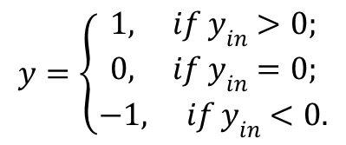


COMPUTATIONS
All the inputs are to be presented to the network one after another to complete one epoch
Let us set the initial weights and bias as
The net input for the first input is
The output ‘y’ is computed by applying activation function over the net input. So, taking the threshold
As t = 1 and y = 0, we have . So, weight updation takes place
$$θ=0$$

Slide 25

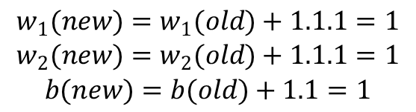
COMPUTATIONS
Using
These values are used for the next input

Slide 26
COMPUTATIONS
Input |  | b | Target | input | Output | Updated Weights
x1 | x2 | 1 | t | yin | y | w1 | w2 | b
EPOCH 1
1 | 1 | 1 | 1 | 0 | 0 | 1 | 1 | 1
1 | -1 | 1 | -1 | 1 | 1 | 0 | 2 | 0
-1 | 1 | 1 | -1 | 1 | 1 | 1 | 1 | -1
-1 | -1 | 1 | -1 | -3 | -1 | 1 | 1 | -1
EPOCH 2
1 | 1 | 1 | 1 | 1 | 1 | 1 | 1 | -1
1 | -1 | 1 | -1 | -1 | -1 | 1 | 1 | -1
-1 | 1 | 1 | -1 | -1 | -1 | 1 | 1 | -1
-1 | -1 | 1 | -1 | -1 | -1 | 1 | 1 | -1

Slide 27

COMPUTATION
The stopping conditions are:
All the calculated outputs are equal to the target outputs
When a separating line is obtained using the final weights for separating the positive responses from the negative responses
After the second epoch the target outputs are equal to the computed outputs
The weights after the second epoch are
Since the threshold value is ‘0’ the separating line is

Slide 28
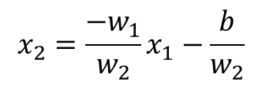
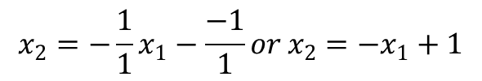





COMPUTATION
S
So,
-
(0, 1)
+
(1, 0)
-
-

Slide 29
EXAMPLE-5
Find the weights using perceptron network for ANDNOT function when all the inputs are presented only one time. Use bipolar inputs and targets
The truth table for the ANDNOT function using bipolar inputs and targets is
x1 | x2 | t
1 | 1 | -1
1 | -1 | 1
-1 | 1 | -1
-1 | -1 | -1

Slide 30
NETWORK STRUCTURE
S

Slide 31
COMPUTATIONS
Let us take
First input: (1, 1, -1)
The output using activation function is

Slide 32
COMPUTATIONS
So, output (y = 0) (t = -1)
So weight updation is necessary
The new weights are (-1, -1, -1)

Slide 33
COMPUTATIONS
Second input: (1,-1,1)
So, new weights are to be computed
The new weights are (0, -2, 0)

Slide 34
COMPUTATIONS
Third input: (-1,1,-1)
Weight updation is not necessary
So, new weights are not to be computed
Fourth input: (-1, -1, -1)
So, new weights are to be computed

Slide 35
COMPUTATIONS
S
The new weights are (1, -1, -1)

Slide 36
FINAL ANALYSIS
 | Input |  | Target | Net Input | Calculated output | Updated | weights
x1 | x2 | b | t | yin | y | w1 | w2 | b
1 | 1 | 1 | -1 | 0 | 0 | -1 | -1 | -1
1 | -1 | 1 | 1 | -1 | -1 | 0 | -2 | 0
-1 | 1 | 1 | -1 | -2 | -1 | 0 | -2 | 0
-1 | -1 | 1 | -1 | 2 | 1 | 1 | -1 | -1

Slide 37
EXAMPLE-6
Find the weights required to perform classification using perceptron network.
The vectors (1, 1, 1, 1) and (-1, 1, -1, -1) are belonging to the class (so have target value 1),
vectors (1, 1, 1,-1) and (1, -1, -1, 1) are not belonging to the class (so we have target value -1).
Assume learning rate as 1 and initial weight as 0.

Slide 38
INITIAL TABLE
The truth table is given by
x1 | x2 | x3 | x4 | b | t
1 | 1 | 1 | 1 | 1 | 1
-1 | 1 | -1 | -1 | 1 | 1
1 | 1 | 1 | -1 | 1 | -1
1 | -1 | -1 | 1 | 1 | -1

Slide 39
COMPUTATIONS
Here we take . Also,
The activation function is given by
The net input is given by
The next table reflects the training performed with weights computed

Slide 40
COMPUTATIONS
 | Input |  |  |  | Target | Net Input | Output | Up | da | ted | Weig | hts
x1 | EPOCH-1 x2 | x3 | x4 | b | t | Y in | y | w1 | w2 | w3 | w4 | b
1 | 1 | 1 | 1 | 1 | 1 | 0 | 0 | 1 | 1 | 1 | 1 | 1
-1 | 1 | -1 | 1 | 1 | 1 | -1 | -1 | 0 | 2 | 0 | 0 | 2
1 | 1 | 1 | -1 | 1 | -1 | 4 | 1 | -1 | 1 | -1 | 1 | 1
1 | -1 | -1 | 1 | 1 | -1 | 1 | 1 | -2 | 2 | 0 | 0 | 0

Slide 41
COMPUTATIONS
 | Input |  |  |  | Target | Net Input | Output | Up | da | ted | Weig | hts
x1 | EPOCH-2 x2 | x3 | x4 | b | t | Y in | y | w1 | w2 | w3 | w4 | b
1 | 1 | 1 | 1 | 1 | 1 | 0 | 0 | -1 | 3 | 1 | 1 | 1
-1 | 1 | -1 | 1 | 1 | 1 | 3 | 1 | -1 | 3 | 1 | 1 | 1
1 | 1 | 1 | -1 | 1 | -1 | 4 | 1 | -2 | 2 | 0 | 2 | 0
1 | -1 | -1 | 1 | 1 | -1 | -2 | -1 | -2 | 2 | 0 | 2 | 0

Slide 42
COMPUTATIONS
 | Input |  |  |  | Target | Net Input | Output | Up | da | ted | Weig | hts
x1 | EPOCH-3 x2 | x3 | x4 | b | t | Y in | y | w1 | w2 | w3 | w4 | b
1 | 1 | 1 | 1 | 1 | 1 | 2 | 1 | -2 | 2 | 0 | 2 | 0
-1 | 1 | -1 | 1 | 1 | 1 | 2 | 1 | -2 | 2 | 0 | 2 | 0
1 | 1 | 1 | -1 | 1 | -1 | -2 | -1 | -2 | 2 | 0 | 2 | 0
1 | -1 | -1 | 1 | 1 | -1 | -2 | -1 | -2 | 2 | 0 | 2 | 0

Slide 43
THE FINAL NET
s

Slide 44
BACK PROPOGATION NETWORK
Back propagation learning algorithm is one of the most important developments in neural networks
This learning algorithm is applied to multilayer feed-forward networks consisting of processing elements with continuous differentiable activation functions
The networks using the back propagation learning algorithm are also called back propagation networks (BPN)
Given a set of input, output pairs this algorithm provides a procedure for changing the weights in a BPN
The basic concept used for weight updation is the gradient-descent method as used in simple perceptron network

Slide 45
GRADIENT DESCENT METHOD
It is a method used to find a local minimum of functions
It starts with an initial guess of the solution
Takes the gradient of the function at that point
The solution is stepped in the negative direction of the gradient
Repeat the process. Suppose, are two successive values in the sequel
Then we have , is a small number that forces the algorithm to make small jumps
For suitable choices of it is guaranteed that

Slide 46
BACK PROPOGATION NETWORK
In this method the error is propagated back to the hidden unit
It differs from other networks in respect to the process by which the weights are calculated during the learning period
When the number of hidden layers is increased the complexity increases
The error is usually measured at the output layer
At the hidden layers there is no information about the errors
So, other techniques are needed to be followed to calculate the error at the hidden layers so that the ultimate error is minimised

Slide 47
ARCITECTURE OF BACK PROPOGATION NETWORK
It is a multi layer, feed forward neural network
It has
one input layer
one hidden layer and
one output layer
The neurons in the hidden and output layer have biases
During the back-propagation phase of learning, signals are sent in the reverse direction
The output obtained from the net can be
Binary {0, 1} / Bipolar {-1, 1}
The activation functions should
increase monotonically, differentiable

Slide 48
DIAGRAMATIC REPRESENTATION OF THE ARCHITECTURE OF BPN
1
1
A
X1
bias
w01
bias
Y1
t1
x1
y1
vo1
Z1
Xi
Yk
yk
t2
x2
vij
wjk
Zj
Ym
Xn
ym
tm
xn
Zp
Input Layer
Hidden Layer
Output Layer

Slide 49





FLOWCHART DESCRIPTION FOR TRAINING PROCESS
x= input training vector [‘n’ in number]
t= target output vector [‘m’ in number]
= learning rate parameter
= input unit
= bias on hidden unit
= bias on output unit
= hidden unit
Then we have input to the hidden unit is given by
$$i^{th}$$
$$j^{th}$$
$$k^{th}$$
$$j^{th}$$
$$j^{th}$$

Slide 50



FLOWCHART DESCRIPTION FOR TRAINING PROCESS CONTD…
The output from the hidden unit is given by
Let be the output unit. The net input to it is
The output from the output unit is
$$j^{th}$$
$$k^{th}$$
$$k^{th}$$

Slide 51
ACTIVATION FUNCTIONS USED
The commonly used activation functions are binary sigmoidal and bipolar sigmoidal functions have the properties:
Differentiable
Monotonously Non-decreasing
So, these functions are used as the activation functions. Here
= Error correction weight adjustment for
This error is at the output unit
This is back-propagated to the hidden units which have fed into

Slide 52
ERROR CORRECTION CONTD…
is the error correction weight adjustment for
This error correction has occurred due to the back propagation of error to the hidden unit

Slide 53
TRAINING ALGORITHM
STEP 0: Initialize weights and learning rate (some random small values are taken)
STEP 1: Perform Steps 2 -9 when stopping condition is false
STEP 2: Perform steps 3 – 8 for each training pair
STEP 3: Each input unit receives input signal , i=1,…n and sends it to the hidden unit
STEP 4: Each hidden unit , j = 1,…p sums its weighted input signals to calculate net input:

Slide 54
TRAINING ALGPORITHM
Calculate the outputs from the hidden layer by applying activation functions over , i.e.
These signals are sent as input signals for the output units
For each output unit , calculate the net input
Apply the activation function to compute the output signal

Slide 55
TRAINING ALGORITHM (BACK PROPAGATION OF ERROR)
STEP 6: Each output unit receives a target pattern to the input training pattern and computes the error correction using:
On the basis of the calculated error correction term, update the change in weights and bias:
Also, send to the hidden layer backwards

Slide 56
TRAINING ALGORITHM (BACK PROPAGATION OF ERROR)
STEP 7: Each hidden unit sums its delta inputs from the output units:
The term gets multiplied with the derivative of
to calculate the error term:
On the basis of the calculated , update the change in the weights and the bias:

Slide 57
TRAINING ALGORITHM (WEIGHTS AND BIAS UPDATION PHASE)
Each output unit, updates the bias and weights as:
Each hidden unit, updates its bias and weights as:
STEP 9: Check for the stopping condition. The stopping condition may be a certain number of cycles reached or when actual output is equal to the target output (That is error is zero)

Slide 58
LEARNING FACTORS OF BACK PROPAGATION ALGORITHM
Convergence of the BPN is based upon several important factors
Initial Weights
Learning rate
Upgradation rule
Size and nature of the training set
Architecture (Number of layers and number of neurons per layer)

Slide 59
INITIAL WEIGHTS
Ultimate solution may be affected by the initial weights
These are initialized by small random values
The choice of initial weights determines the speed at which the network converges
Higher initial weights may lead to saturation of activation functions from the beginning by stocking up at a local minimum
One method to select the weights
= The number of processing elements j that feed forward to the ith processing element

Slide 60
INITIAL WEIGHTS CONTD…
I
is the average weight calculated for all i, that is
is the scale factor .
Here, n is the number of input neurons and p is the number of hidden layer neurons

Slide 61
LEARNING RATE
Learning rate also affects the convergence of the network
Larger value of may speed up the convergence but may lead to overshooting
The range of is to 10
Large learning rate leads to rapid learning but there will be oscillation of weights
Lower learning rate leads to slow learning

Slide 62
MOMENTUM FACTOR
To overcome the problems stated above (in the previous slide) we add a factor called momentum factor to the usual gradient descent method
Momentum factor is in the interval [ 0, 1]
is normally taken to be 0.9

Slide 63
NUMBER OF TRAINING DATA
The training data should be sufficient and proper
Training vectors should be taken randomly from the training set
The data set should be representing the input space
Suppose the input space is linearly separable with L disjoint regions
Let T be the lower bound on the number of training patterns
Then T should be selected such that T/L >>1

Slide 64
NUMBER OF HIDDEN LAYER NODES
If the number of hidden layers is more than 1 in a BPN then
the calculations performed for a single layer are repeated
The size of a layer is very important
It is determined experimentally
If the network does not converge then the number of hidden nodes are to be increased
If the network converges then the user may try with a few hidden nodes and settle for a size based on the performance
In general the size of hidden nodes should be a relatively small fraction of the input layer

Slide 65
TESTING ALGORITHM FOR BPN
STEP 0: Initialize the weights. (The weights are taken from the training phase
STEP 1: Perform steps from 2 – 4 for each input vector
STEP 2: Set the activation of input for , I = 1,2,…n
STEP 3: Calculate the net input to hidden unit z and its output
and
STEP 4: Compute the net input and the output of the output layer
USE SIGMOIDAL FUNCTIONS AS ACTIVATION FUNCTIONS

Slide 66
EXAMPLE-1
Using the Back propagation network, find the new weights for the net shown below. It is presented with the input pattern [0,1] and the target output 1. Use a learning rate of 0.25 and binary sigmoidal activation function.

Slide 67
COMPUTATIONS
The initial weights are:
The learning rate: .
The activation function is: Binary sigmoidal , i.e.
The net input:
For :
For :

Slide 68
COMPUTATIONS CONTD…
Outputs:
Output Layer:
Input:
Output:

Slide 69
FINAL WEIGHTS FOR THE FIRST PHASE
The error propagation:
We use the gradient descent formula:
We have,
Here k = 1. So,
We next compute the changes in weights between the hidden and the output layer

Slide 70
COMPUTATIONS CONTD…
So,
Next we compute the error portion between the input and the hidden layer
The general formula is
Each hidden unit sums its delta inputs from the output units. So,

Slide 71
COMPUTATIONS CONTD…
Here, m =1 (the output neuron). So,
So,
Now,
Hence,
Again,
So,

Slide 72
COMPUTATIONS CONTD…
So,

Slide 73
FINAL WEIGHTS FOR THE SECOND PHASE
s

Slide 74
EXAMPLE-2
Find the new weights, using back-propagation network for the network shown below. The network is presented with the input pattern [-1,1] and the target output +1. Use a learning rate of and bipolar sigmoidal activation function.

Slide 75
COMPUTATIONS
Here, the activation function is the bipolar sigmoidal activation function, that is
and
The input vector is [-1, 1] and target vector is t = 1
Learning rate

Slide 76
COMPUTATIONS
The net input:
For :
For :
Outputs:

Slide 77
COMPUTATIONS
For output layer:
Input:
Output

Slide 78
COMPUTATIONS
Error at the output neuron:
We use the gradient descent formula:
Here k = 1. So,
The changes in weights between the hidden and output layer:

Slide 79
COMPUTATIONS
So,
Next we compute the error portion between the input and the hidden layer
The general formula is
Each hidden unit sums its delta inputs from the output units. So,

Slide 80
COMPUTATIONS
Here, m =1 (the output neuron). So,
Hence,
Now,
So,

Slide 81
COMPUTATIONS
and
Now, the changes in the weights between the input and the hidden layer are

Slide 82
FINAL WEIGHTS BETWEEN INPUT AND HIDDEN LAYER
s

Slide 83
RBF NETWORK

Slide 84
A wonderful article on RBF NETWORKS is:
An Introduction to Radial Basis Function Networks
BY
Mark. J. L. Orr
Centre for Cognitive Science
University of Edinburgh
2, Buccleuch Place
Edinburgh, Scotland
April, 1996

Slide 85
RADIAL BASIS FUNCTION
Radial Basis Function (RBF) networks is a type of artificial neural network for application to problems of supervised learning; e.g. regression, classification and time series prediction
Linear models have been studied in statistics for about 200 years and the theory is applicable to RBF networks which are just one particular type of linear model
A ubiquitous (present, appearing or found everywhere) problem in statistics with applications in many areas is to guess or estimate a function from some example input output pairs with little or no knowledge of the form of the function

Slide 86
RADIAL BASIS FUNCTION CONTD…
It has different names in different disciplines; e.g. nonparametric regression function, approximation system identification, inductive learning
In neural network parlance the problem is called supervised learning
The function is learned from the examples which a teacher supplies
The set of examples or training set contains elements which consist of paired values of the independent input variable and the dependent output variable

Slide 87
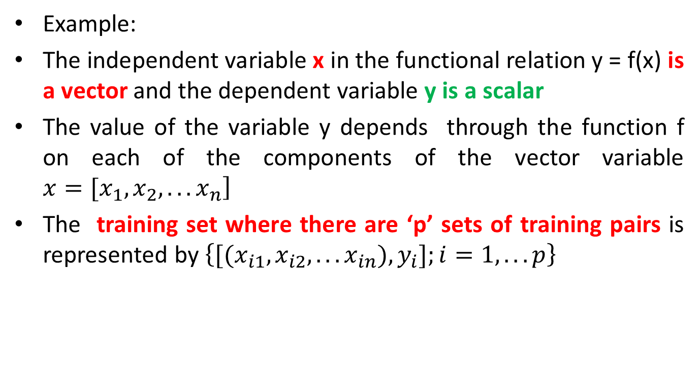
RADIAL BASIS FUNCTION CONTD…
Example:
The independent variable x in the functional relation y = f(x) is a vector and the dependent variable y is a scalar
The value of the variable y depends through the function f on each of the components of the vector variable $\left.x=[x_{1},x_{2},...x_{n}\right]$
The training set where there are ‘p’ sets of training pairs is represented by $\left\{[(x_{i1},x_{i2},...x_{in}),y_{i}];i=1,...p\right\}$

Slide 88
SIMILARITY BETWEEN STATISTICS AND NEURAL NETWORKS
table
Statistics | Neural Networks
Model | Networks
Estimation | Learning
Regression | Supervised learning
Interpolation | Generalisation
Observations | Training Set
Parameters | Synaptic Weights
Independent Variables | Inputs
Dependent Variables | Outputs

Slide 89

RADIAL FUNCTIONS
Radial functions are a special class of function
Their characteristic feature is that their response decreases (or increases) monotonically with distance from a central point
A typical radial function is the Gaussian which in the case of a scalar input is

Slide 90
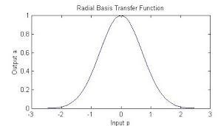
GAUSSIAN RBF
Its parameters are its centre c and its radius r.
The figure above illustrates a Gaussian RBF with centre c and radius r.

Slide 91
RADIAL BASIS FUNCTION NETWORKS
Radial functions are simply a class of functions
In principle they could be employed in any sort of model (linear or nonlinear) and any sort of network (single layer or multilayer)

Slide 92
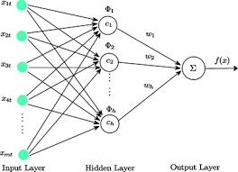
RADIAL BASIS FUNCTION NETWORKS CONTD…
Each of n components of the input vector x feeds forward to m basis functions whose outputs are linearly combined with weights into the network output f(x)

Slide 93
RADIAL BASIS FUNCTION NETWORKS CONTD…
An RBF network is nonlinear if the basis functions can move or change size or if there is more than one hidden layer
Here we focus on single layer networks with functions which are fixed in position and size
We do use nonlinear optimisation but only for the regularisation parameter(s) in ridge regression and the optimal subset of basis functions in forward selection

Slide 94
RADIAL BASIS FUNCTION NETWORKS CONTD…
We also avoid the kind of expensive nonlinear gradient descent algorithms (such as the conjugate gradient and variable metric methods) that are employed in explicitly nonlinear networks
Keeping one foot firmly planted in the world of linear algebra makes analysis easier and computations quicker.

Slide 95
STANDARD RBF NETWORK
The architecture consists of two layers whose output nodes form a linear combination of the basis functions computed by means of the RBF nodes or hidden layer nodes

Slide 96
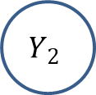



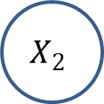

THE ARCHITECTURE OF RBF
g
v11
x1
$$Z_{1}$$
w11
$$Y_{1}$$
y1
v12
w12
vn1
wm1
v21
w21
x2
$$X_{2}$$
$$Z_{2}$$
$$Y_{2}$$
y2
v22
w22
w2k
v2m
wm2
v1m
wm1
w1k
vn2
xn
vnm
wmk
$$Y_{k}$$
yn
Input Layer
Hidden Layer (RBF)
Output Layer

Slide 97
TRAINING ALGORITHM
STEP 0: Set the weights to small random values
STEP 1: Perform Steps 2-8 when the stopping condition is false
STEP 2: Perform Steps 3-7 for each input
STEP 3: Each input unit (xi, I = 1, 2…n) receives input signals and transmits to the next hidden layer unit
STEP 4: Calculate the radial basis function
STEP 5: Select the centres for the radial basis function. The centres from the set of input vectors. It should be noted that sufficient number of centres have to be selected to ensure adequate sampling of the input vector space

Slide 98

TRAINING ALGORITHM
STEP 6: Calculate the output from the hidden layer unit
$v_{i}(x_{i})=\frac{exp\left[−\sum_{j=1}^{r}{{\left(x_{ji}−x_{ji}^{∧}\right)}^{2}}\right]}{σ_{i}^{2}}$
Where
$x_{ji}^{∧}$ is the centre of the RBF unit for the input variables
$σ_{i}$ is the width of the RBF unit
$x_{ji}$ is the jth variable of input pattern
STEP 7: Calculate the output of the neural network

Slide 99

TRAINING ALGORITHM CONTD…
$y_{net}=\sum_{i=1}^{k}{\left.w_{im}v_{i}(x_{i}\right)}+w_{0}$
where
k = number of hidden layer nodes
$y_{net}$= output value of mth node in the output layer for the nth incoming pattern
$w_{im}$ is the weight between ith RBF unit and mth output node
$w_{0}$ the biasing term at the nth output node
STEP 8: Calculate the error and test for the stopping condition. The stopping condition may be number of epochs or to a certain extent weight change

Slide 100
FLOW CHART FOR TRAINING PROCESS OF RBF
g
START
SSet weights to small random values
For each input
NO
YES

Slide 101
FLOW CHART FOR TRAINING PROCESS OF RBF
g
Compute radial basis function
Select centres of RBF functions: sufficient number has to be selected to ensure adequate sampling
Calculate output of hidden layer unit

Slide 102
FLOW CHART FOR TRAINING PROCESS OF RBF
g
Set output layer weights to small random values
Compute the output of the neural networks
Find error

Slide 103
FLOW CHART FOR TRAINING PROCESS OF RBF
g
If no epochs (or) no weight change
No
Yes
STOP

Slide 104
ADALINE

Slide 105
ADAPTIVE LINEAR NEURON- ADALINE
The input-output relationship is linear
It uses bipolar activation for its input signals and its target output
The weights between the input and the output are adjustable
The bias acts like an adjustable weight
It has only one output unit
An Adaline can be trained by using delta rule
The delta rule is also called as Least Mean Square (LMS) rule or Widrow-Hoff rule

Slide 106
DELTA RULE FOR SINGLE OUTPUT UNIT
The W-F rule is similar to the perceptron rule
It is derived from the gradient-descent method
Perceptron learning rule stops after a finite number of learning steps
But, the gradient-descent approach continues for ever, converging only asymptotically to the solution
The delta rule updates the weights between the connections so as to minimize the difference between the net input to the output unit and the target value
The major aim is to minimize the error over all training patterns

Slide 107
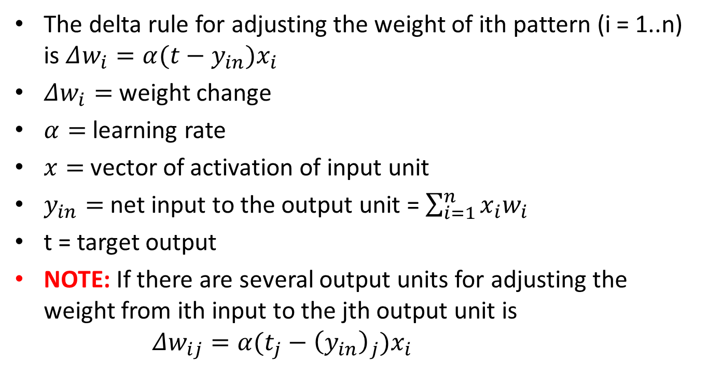
DELTA RULE FOR SINGLE OUTPUT UNIT CONTD..
The delta rule for adjusting the weight of ith pattern (i = 1..n) is $Δw_{i}=α(t−y_{in})x_{i}$
$Δw_{i}=$ weight change
$α=$ learning rate
$x=$ vector of activation of input unit
$y_{in}=$ net input to the output unit = $\sum_{i=1}^{n}{x_{i}w_{i}}$
t = target output
NOTE: If there are several output units for adjusting the weight from ith input to the jth output unit is $Δw_{ij}=α(t_{j}−{\left(y_{in}\right)}_{j})x_{i}$

Slide 108
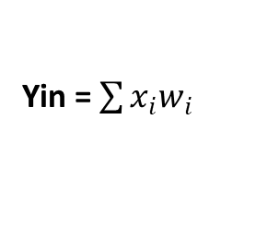
ARCHITECTURE OF ADALINE
g
x0 = 1
1
b
x1
X1
w1
Yin
Yin = $\sum{x_{i}w_{i}}$
f(Yin)
w2
Y
x2
X2
wn
Yin
x3
Xn
e = t- Yin
Adaptive Algorithm
Output error generator
t
Learning supervisor

Slide 109
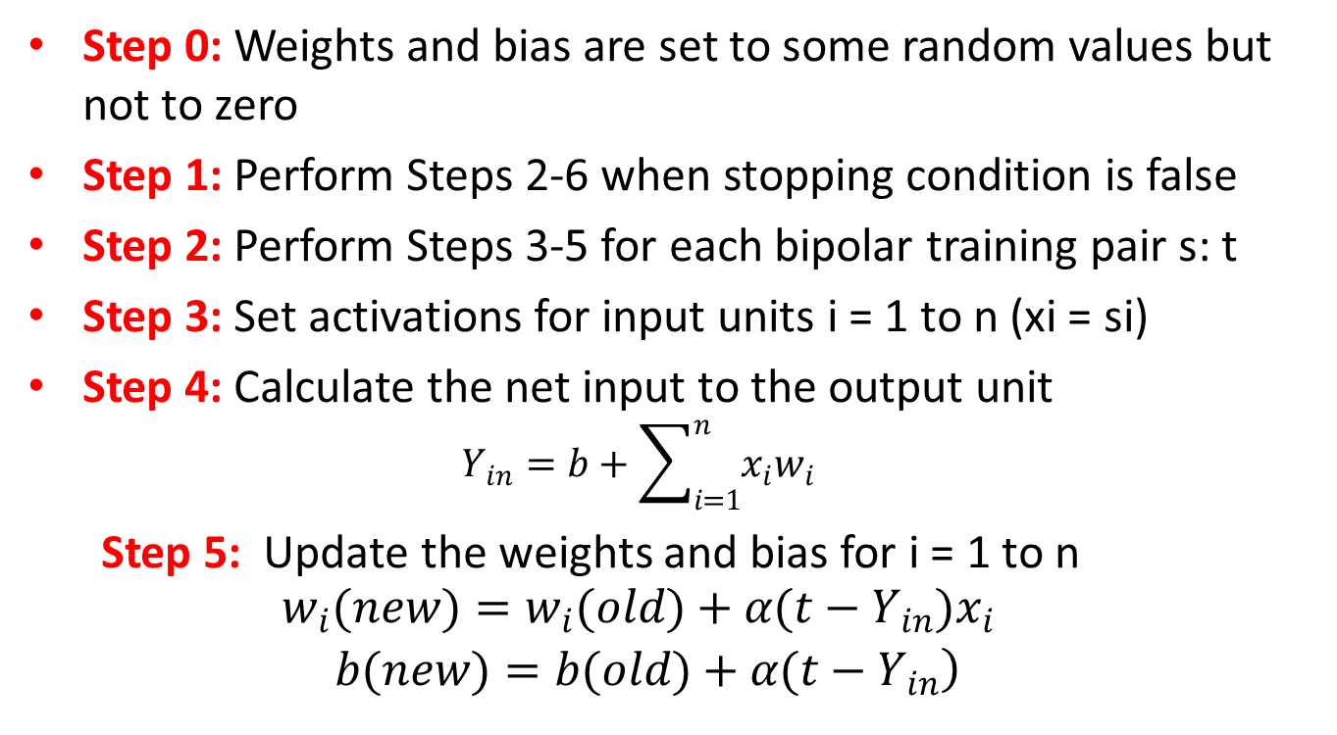
TRAINING ALGORITHM
Step 0: Weights and bias are set to some random values but not to zero
Step 1: Perform Steps 2-6 when stopping condition is false
Step 2: Perform Steps 3-5 for each bipolar training pair s: t
Step 3: Set activations for input units i = 1 to n (xi = si)
Step 4: Calculate the net input to the output unit
$$Y_{in}=b+\sum_{i=1}^{n}{x_{i}w_{i}}$$
Step 5: Update the weights and bias for i = 1 to n
$$\begin{matrix}w_{i}(new)=w_{i}(old)+α(t−Y_{in})x_{i} \\ \left. b(new)=b(old)+α(t−Y_{in}\right)\end{matrix}$$

Slide 110
TRAINING ALGORITHM CONTD…
Step 6: If the highest weight change that occurred during training is smaller than a specified tolerance then stop the training process, else continue
The learning rate can be between 0.1 and 1.0

Slide 111
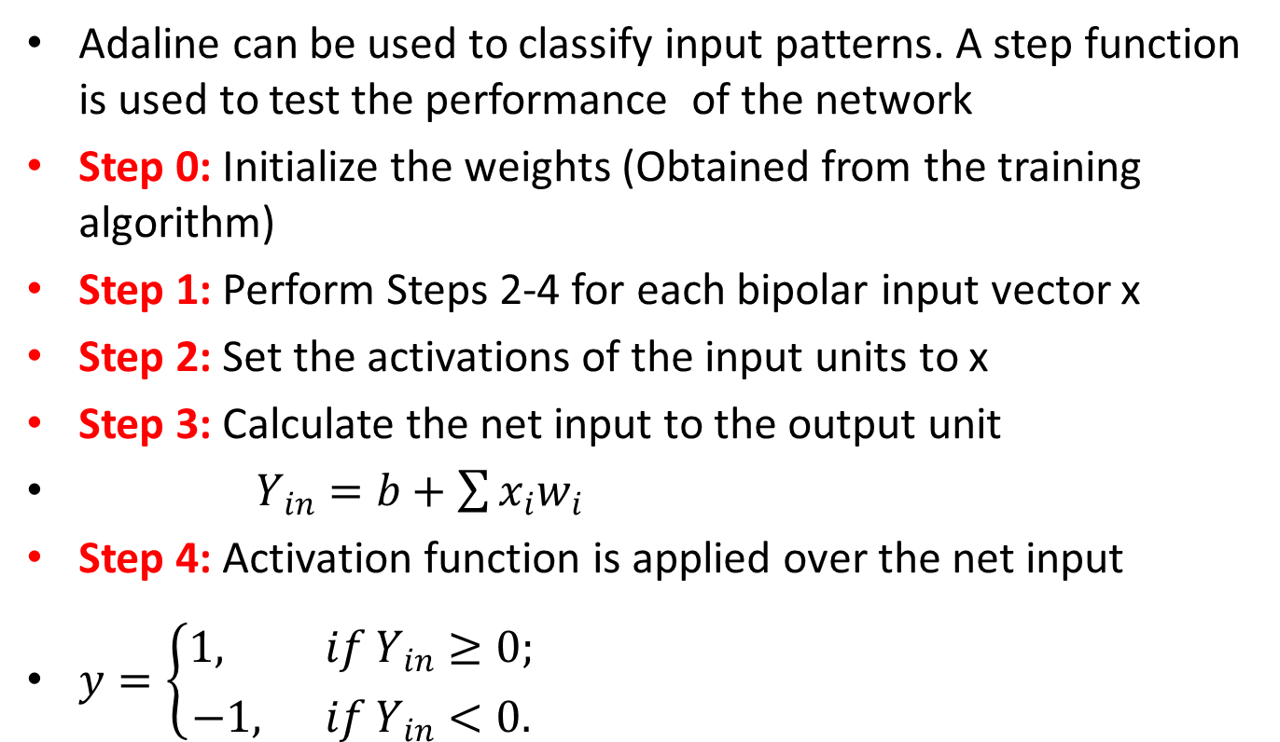
TESTING ALGORITHM
Adaline can be used to classify input patterns. A step function is used to test the performance of the network
Step 0: Initialize the weights (Obtained from the training algorithm)
Step 1: Perform Steps 2-4 for each bipolar input vector x
Step 2: Set the activations of the input units to x
Step 3: Calculate the net input to the output unit
$Y_{in}=b+\sum{x_{i}w_{i}}$
Step 4: Activation function is applied over the net input
$y=\left\{\begin{matrix}1, if Y_{in}≥0; \\ −1, if Y_{in}<0.\end{matrix}\right.$

